Slide 1
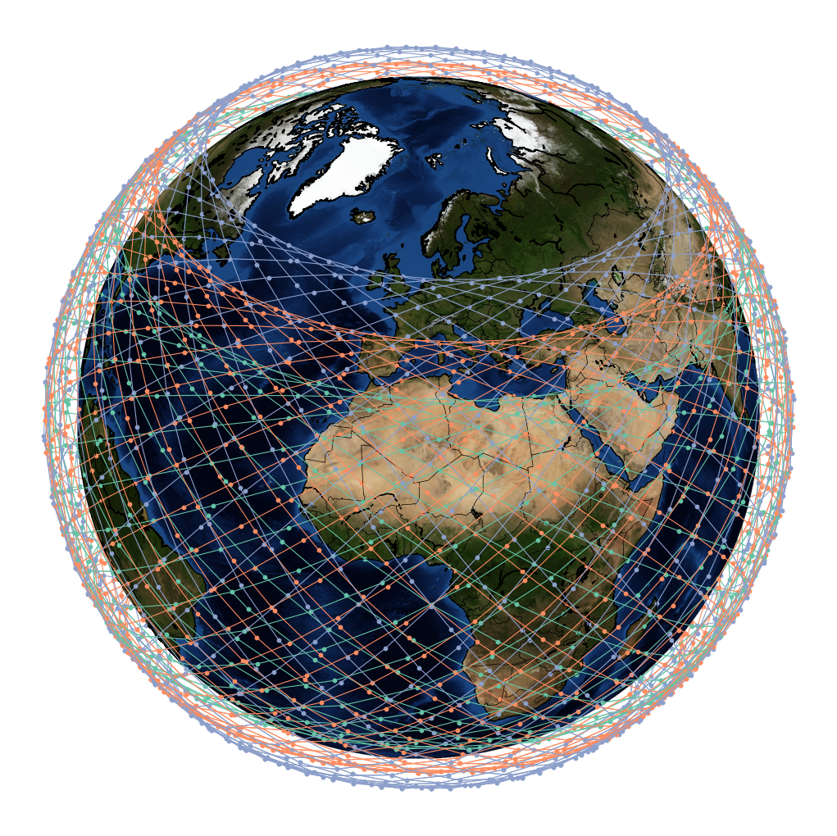
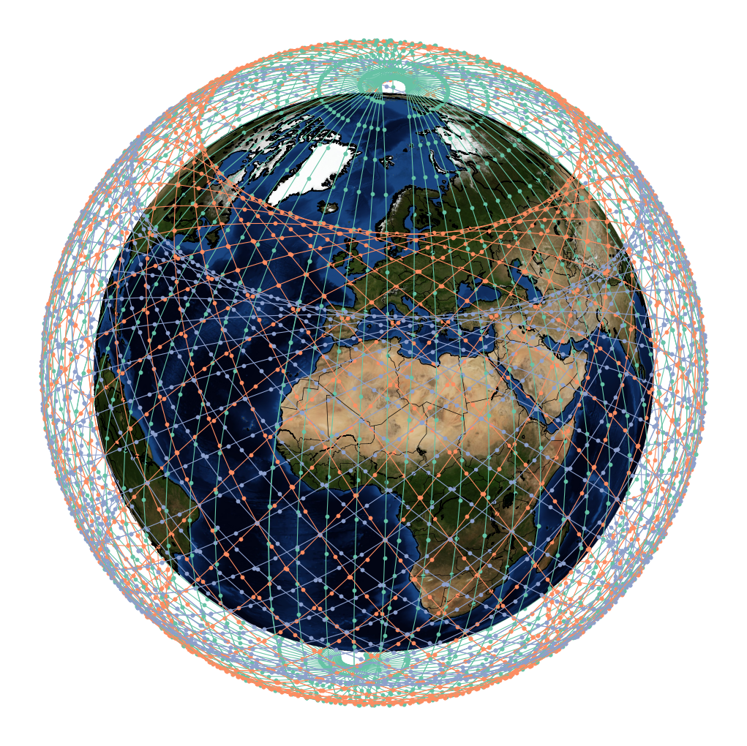
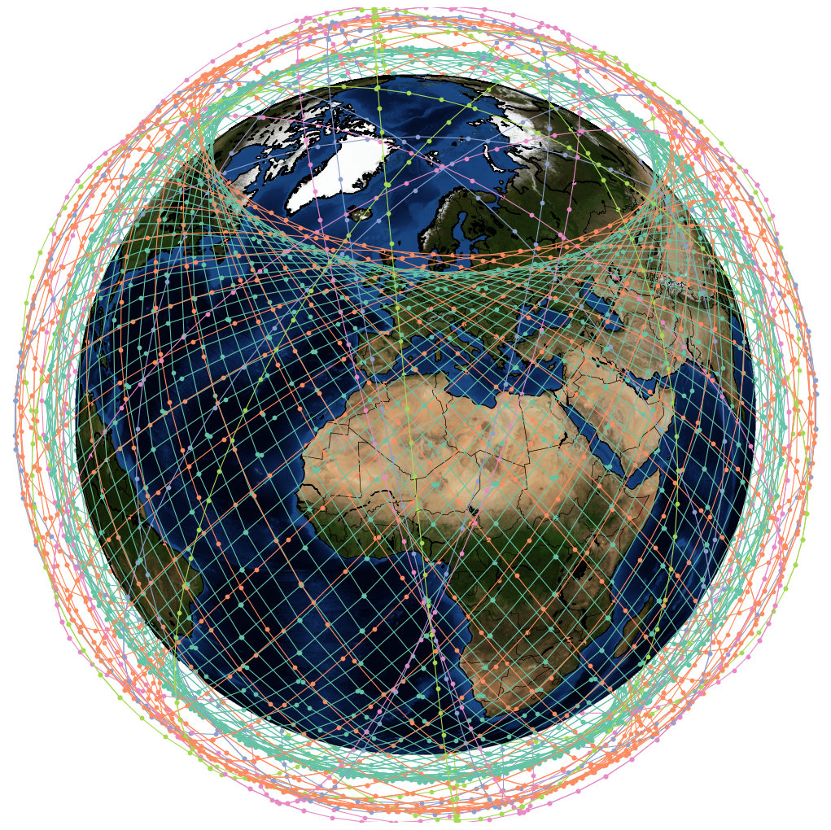
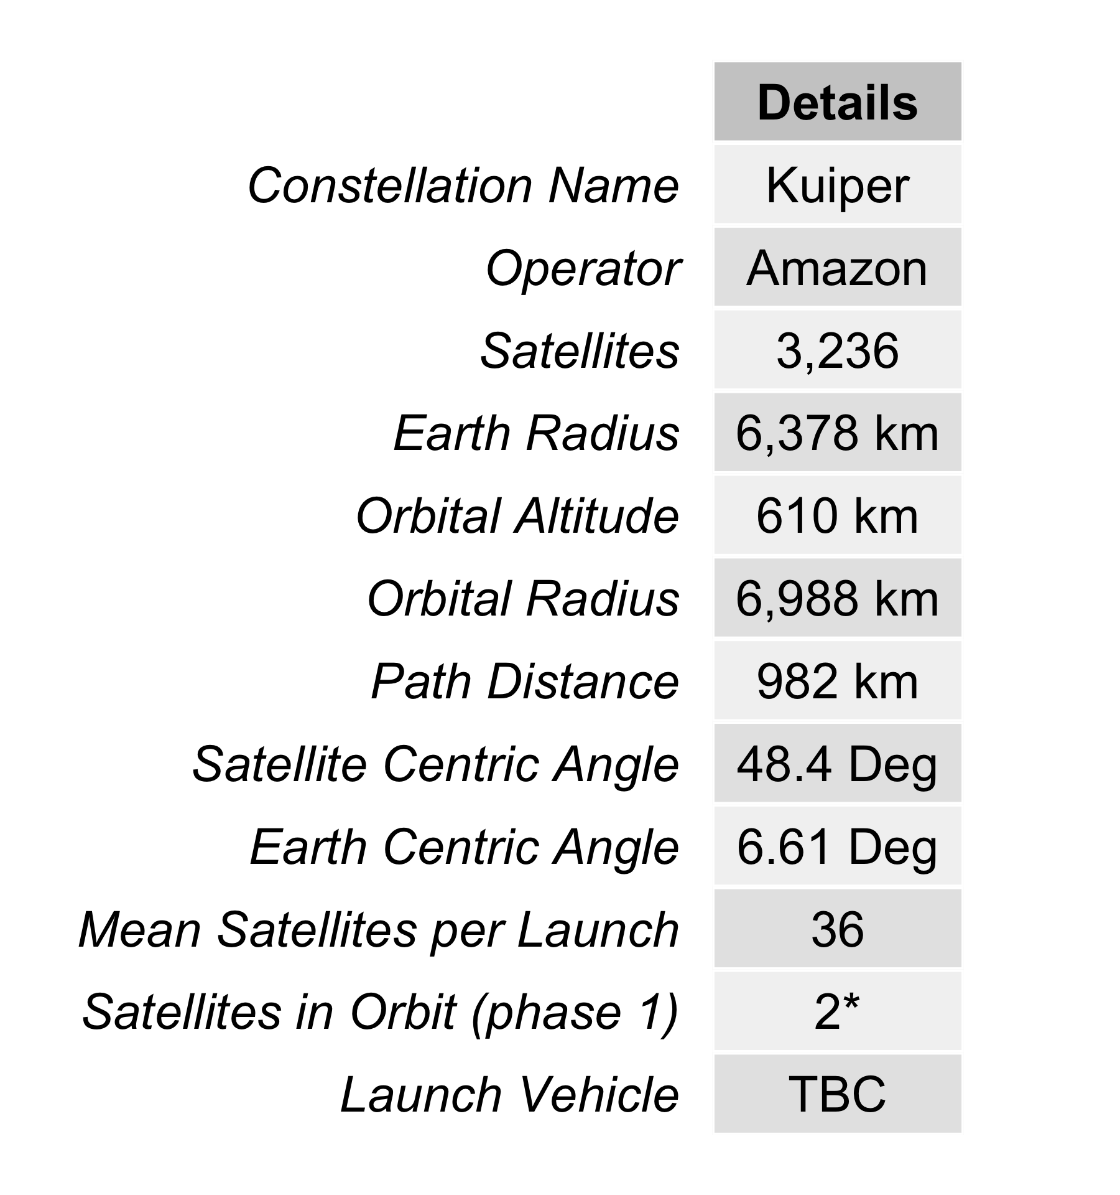
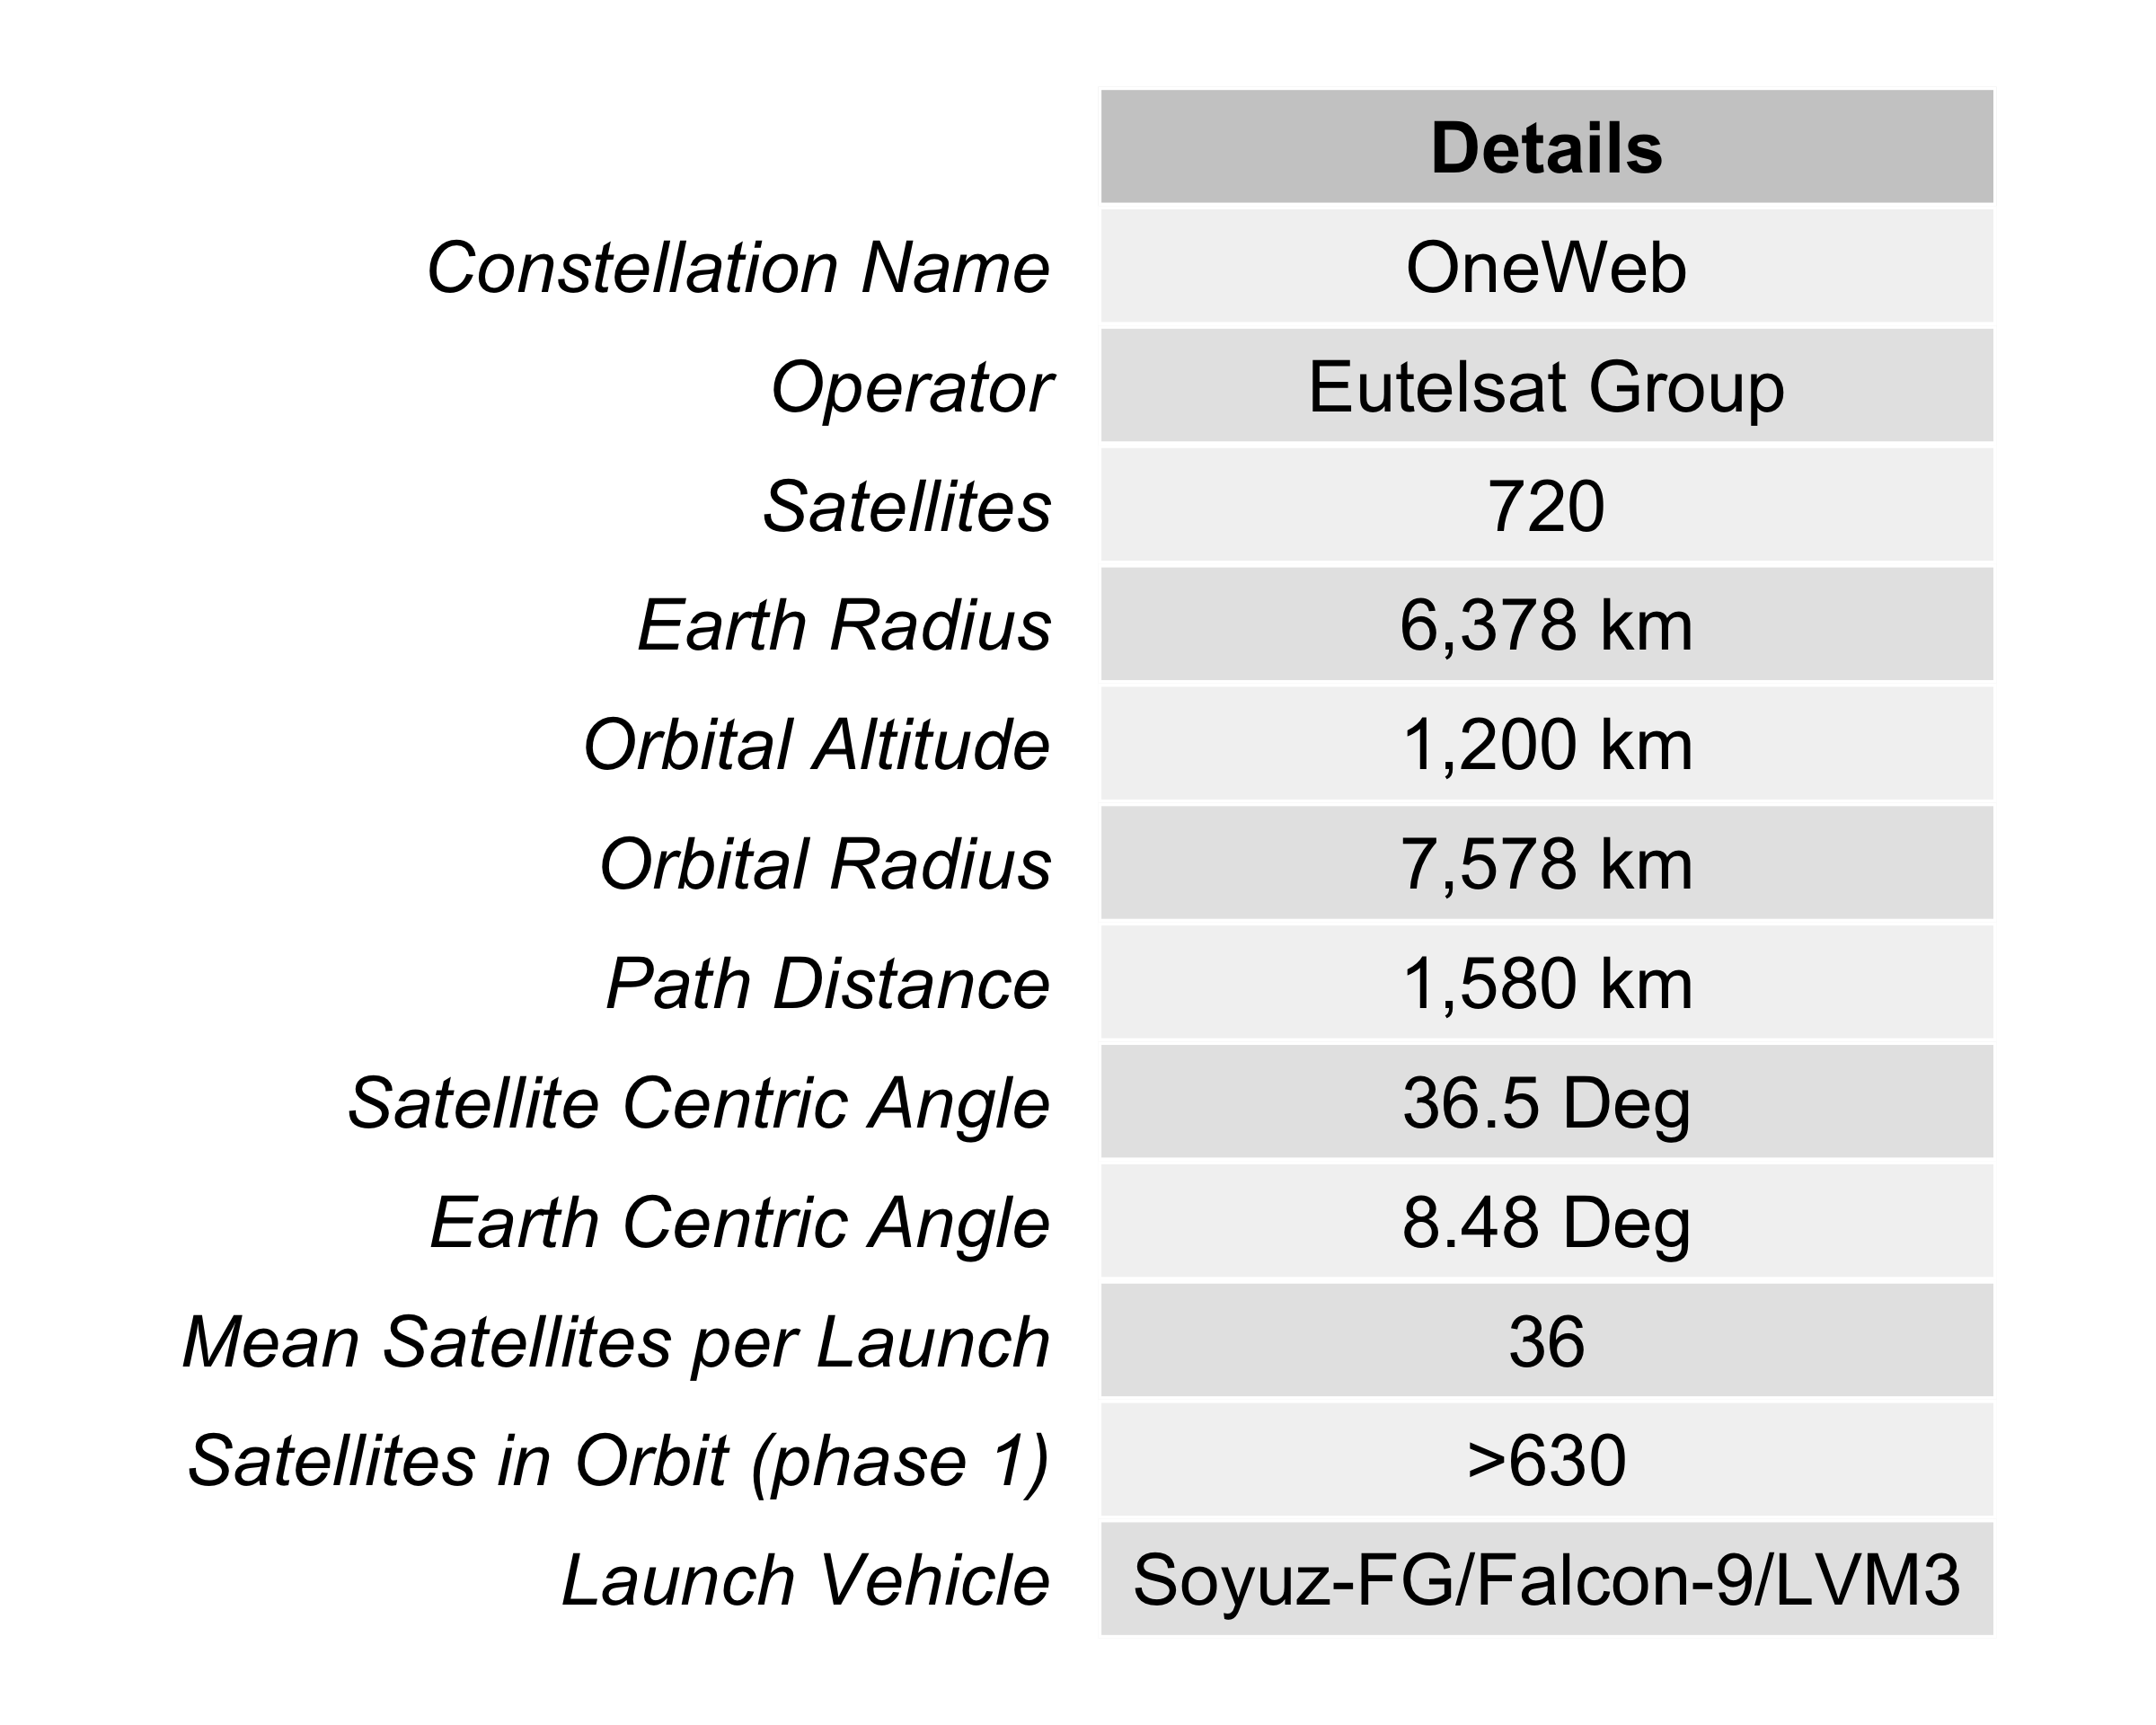
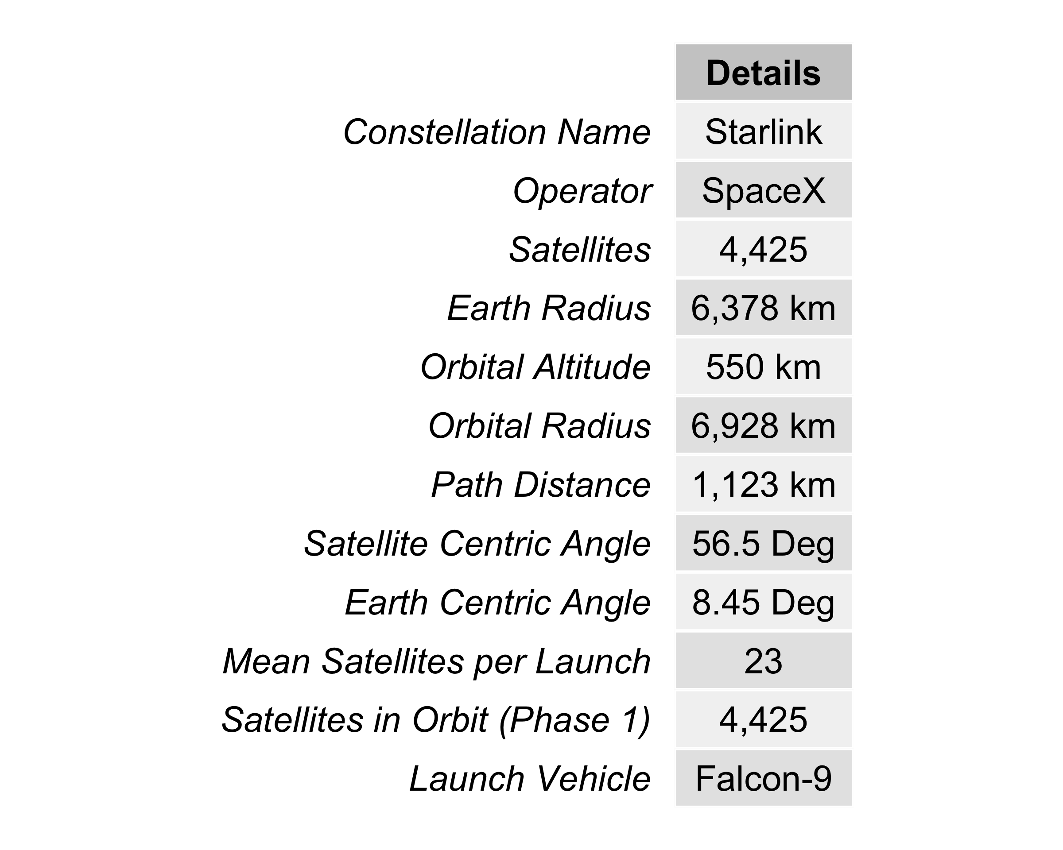
a
b
c
d
e
f

Slide 2
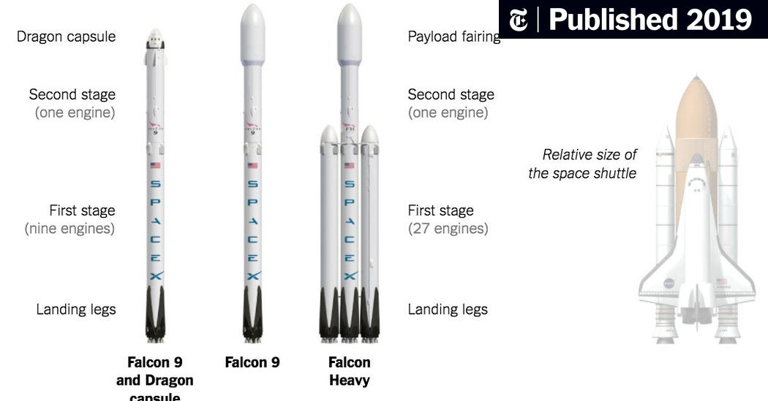
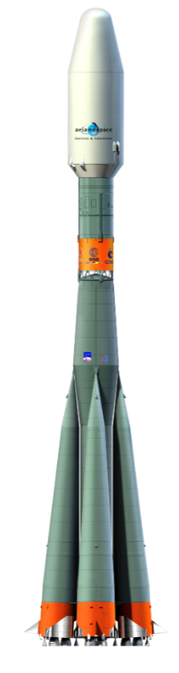
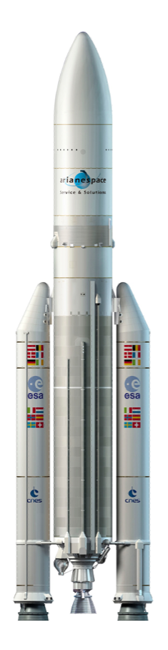
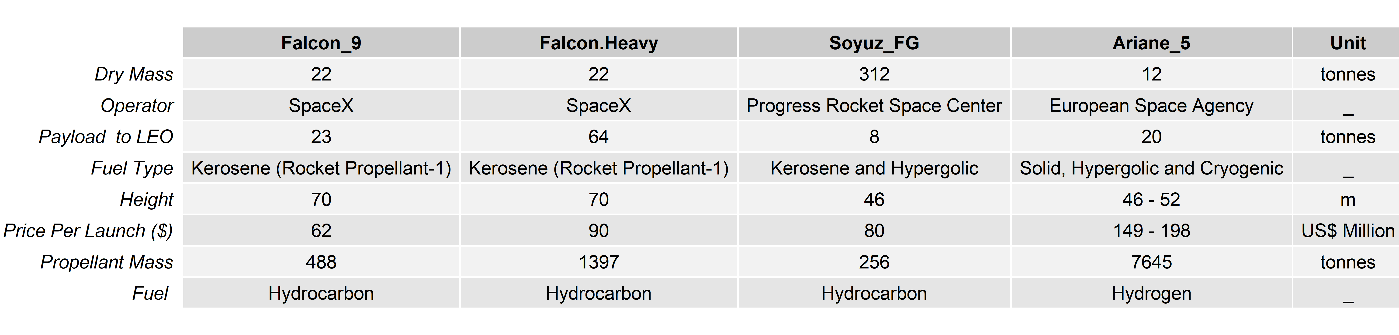

Slide 3
Total Constellation Emissions
Minimum Elevation Angle
Path Loss
Orbital Altitude
Launch Event
Link Budget
Lifecycle Management of Propellant
Launch Campaign
Launcher Assembly and Testing
Channel Capacity
Satellite Capacity
Number of Satellites
Production of Propellant
Launcher Production & Development
Transportation of Launcher
Total Usable Constellation Capacity
LCA Model
Capacity Model
LEO Sustainability Analytics
Emissions
Capacity
Demand
Costs
Demand Model
Cost Model
Adoption Rate (%)
Market Share (%)
Admin Area (km²)
Population Data
Assessment Period
(Years)
Total Cost of Ownership (TCO) ($US)
Discount
Rate (%)
Active Users (%)
Population Density (Pop/km2)
Capital Expenditure
Operational Expenditure
Manufacture
Customer Acquisition
Maintenance
R&D
Rocket Launches
Regulatory
Staff
Infrastructure
Active User Density (Users/km²)
Ground Stations
Spectrum
Energy

Slide 4
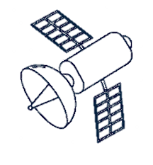



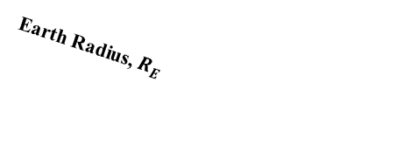
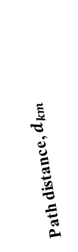

Satellite Orbit
$$β$$
Orbital altitude (h)
Path distance, $d_{km}$
Subsatellite point
$$ε_{min}$$
User Terminal
$$φ$$
Earth Radius, $R_{E}$
Earths Center

